Slide 1
Which statement about virtual memory is incorrect?
Only part of the program needs to be in memory for execution.
Allows address spaces to be shared by several processes.
Less I/O needed to load or swap processes.
Virtual memory directly accesses physical storage without using any address translation.

Slide 2
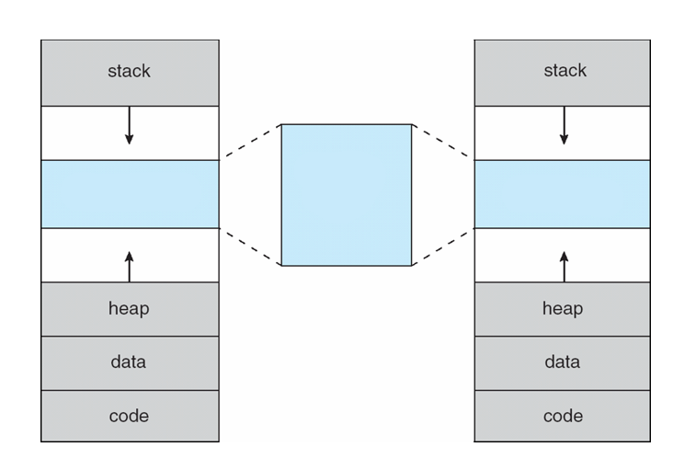
Fill in the blanks.

Slide 3
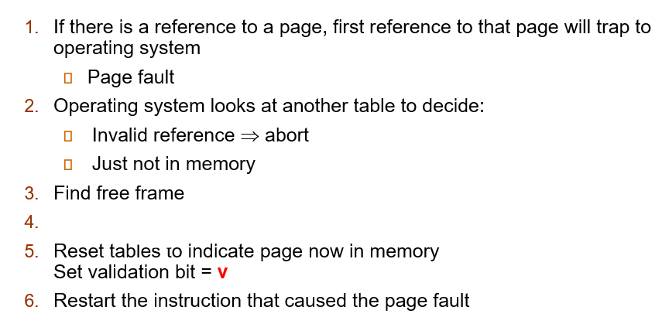
Fill in the blanks.

Slide 4
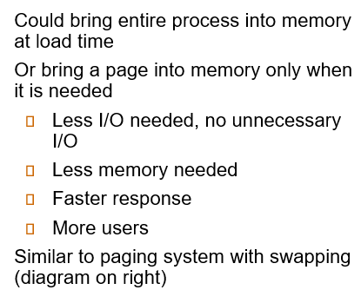
What is being explained in the question?

Slide 5
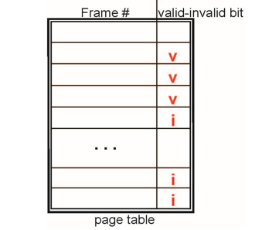
When does a page fault occur in a page table?

Slide 6
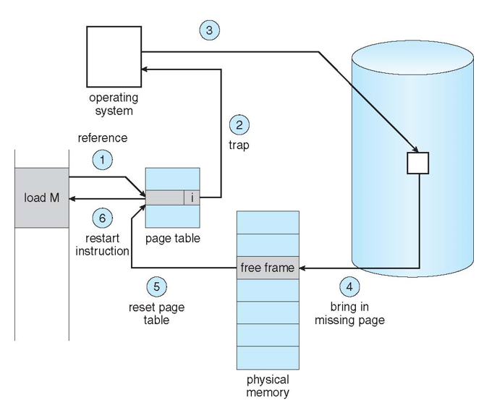
What is the third step in handling a page fault?

Slide 7

What happens if the page fault rate is zero?

Slide 8

Explain briefly about copy-on-write.

Slide 9
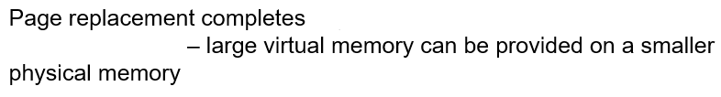
Fill in the blanks.

Slide 10
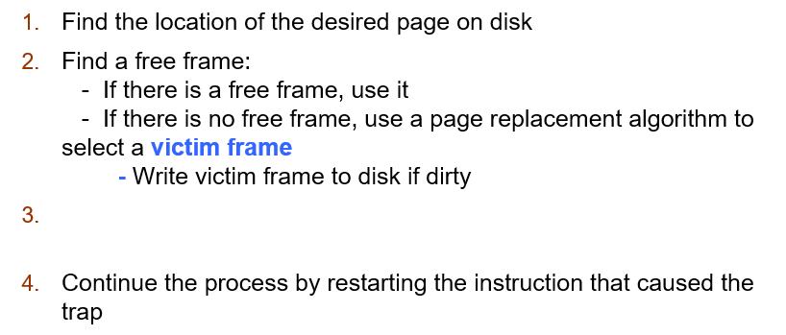
What is the third step in basic page replacement?

Slide 11

Explain briefly about Frame-allocation algorithm.

Slide 12
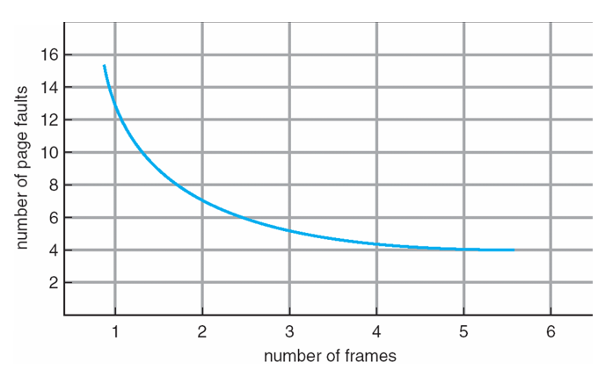
What can be inferred from the graph?

Slide 13
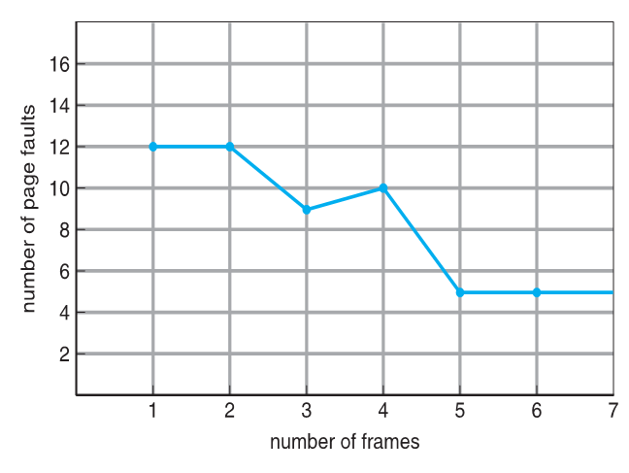
Explain Belady's Anomaly briefly based on the graph.

Slide 14
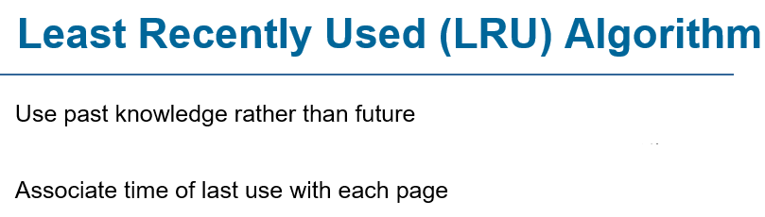
Fill in the blanks.

Slide 15
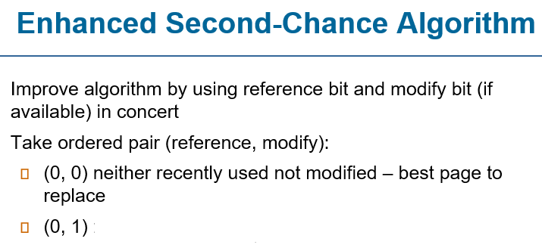
Fill in the blanks.

Slide 16
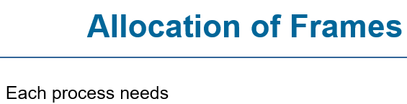
Fill in the blanks.

Slide 17
Fill in the blanks.

Slide 18
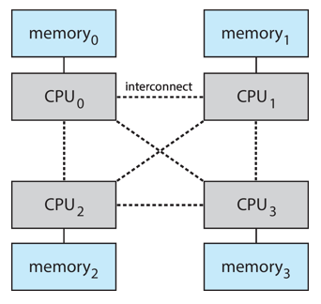
Explain Non-Uniform Memory Access (NUMA) based on the diagram.

Slide 19
Fill in the blanks.

Slide 20
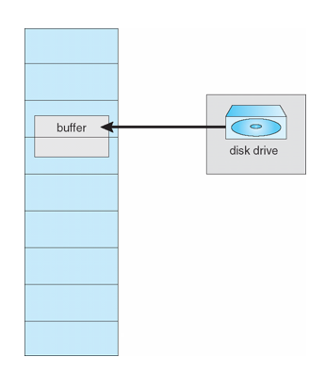
Explain I/O interlock based on the diagram.

